Slide 1
Olist store Analysis
Presented by
Mali Sheetal
Santosh Chanukya
Sarvmbh sawant
Amit Singh
Sukhad Borde

Slide 2
agenda
Introduction
Data Overview
KPI’S
Dashboards
Insights and Recommendations

Slide 3
Introduction
The Olist Store Analysis project aims to improve its sales and by analysing customer purchasing patterns and payment statistics on an E commerce platform, Olist. This project covers several key performance indicators (KPIs) such as weekday vs weekend sales, payment statistics, delivery time, and customer behavior. The analysis is based on nine CSV files, Over View which are cleaned and manipulated to extract valuable insights.

Slide 4
​Data consists of around 100k orders from 2016 to 2018 placed by customers on Olist from several sellers located across brazil. There are 9 CSV files : Olist customers Dataset Olist geological Dataset Olist order items Dataset Olist order payment Dataset Olist order Review Dataset Olist orders Dataset Olist Products Dataset Olist sellers Dataset Product category name translation
Data Overview

Slide 5



Tools Used :
MS- excel
Power-bi
tableau
My sql

Slide 6
KPI’S
● Weekdays and weekend payment statistics
● Payment Type with review score 5
● Average numbers of delivery days taken for pet shop
● Average price and payment value of sao paulo city
● Average shipping days vs review scores

Slide 7
KPI 1 : Weekdays and weekend payment statistics

Slide 8
KPI 2 : Payment Type with review score 5

Slide 9
KPI 3 : Average numbers of delivery days taken for pet shop
This KPI analyzes the average number of days taken for order delivered customer date for pet shop. It helps Olist in identifying areas where they can improve their delivery time and maintain customer satisfaction. With this KPI olist can analyze each product category’s delivery days and identify which product is taking how many days to deliver,which inturns helps in minimizing the shipping days for those products which are taking longer number of days to deliver and gain customer satisfaction.

Slide 10
KPI 4 : Average price and payment value of sao paulo city

Slide 11
KPI 5 :Average shipping days vs review scores

Slide 12
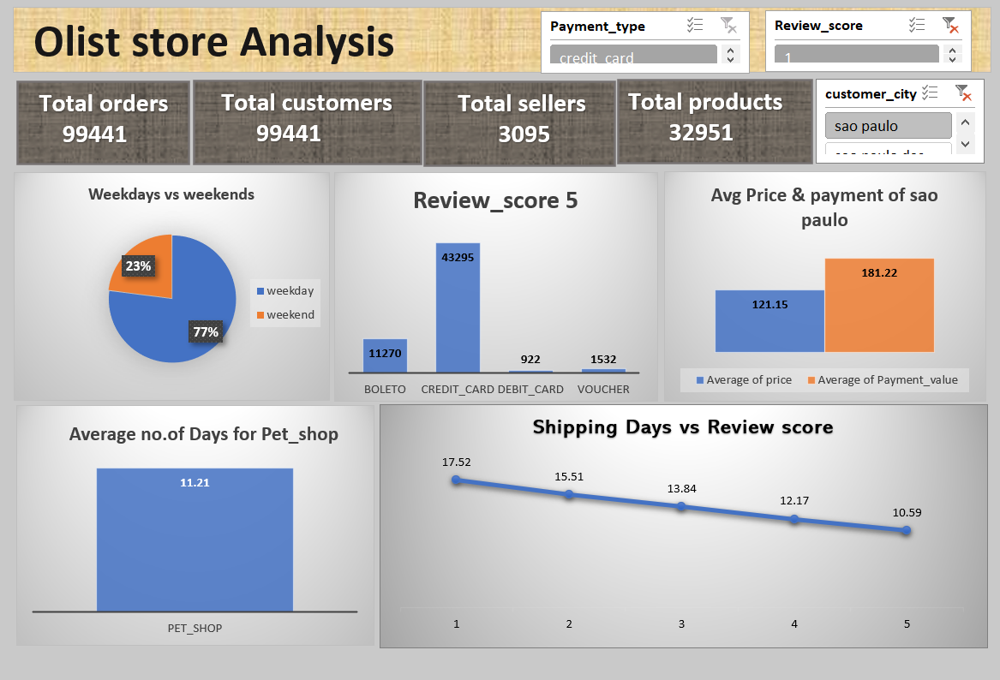
Excel Dashboard :

Slide 13
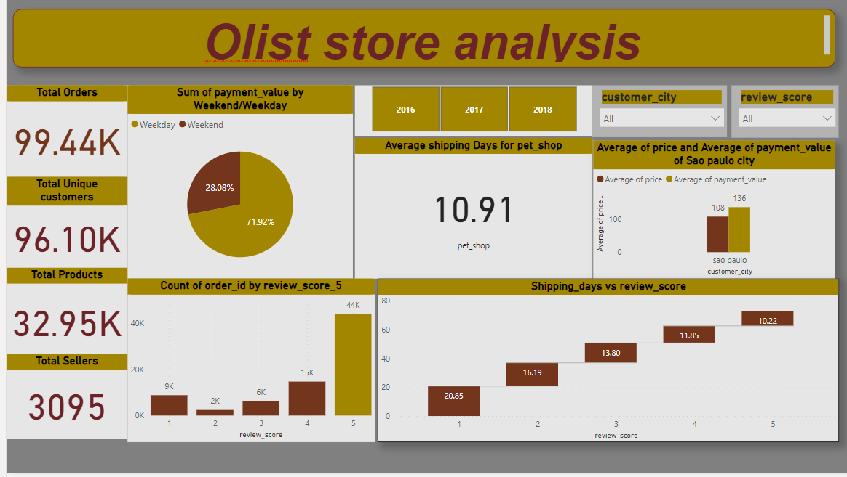
PowerBI Dashboard :

Slide 14
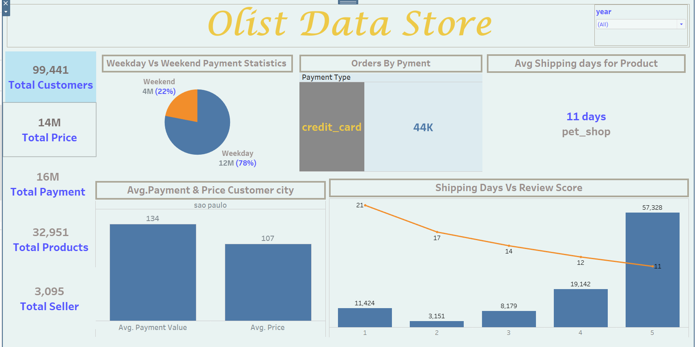
Tableau Dashboard :

Slide 15
Insights :
According to the data, Olist E-commerce has about 99,441 orders.
With about 89,940 orders being delivered, the company has a 90% delivery success rate.
Total customers are 99,441,Total products are 32951 and Total sellers are 3095.
Customers average product rating is 4.09 stars, with product categories going as high as 4.67 stars and as low as 2.5 stars.
1 Star reviews are on third place in the review score distribution ranking which likely indicates that there could be problems with product quality in some product categories.
Delivery performance could also influence review scores and success rate could certainly be improved.
Insights from this analysis can help in making business decisions, such as focusing on products that customers are interested in, improving product and service quality, and optimizing marketing in provinces with high total sales. In addition, this analysis also provides an overview of customer consumption trends and patterns that can be used to direct further business strategies.

Slide 16
Recommandations :
Regularly monitor and analyze customer reviews to gain insights in product quality and identify areas for improvement.
Dashboards can be used to identify patterns in customer reviews. This will provide a data-driven approach to enhance customer experience.
Investigate delivery delays and undelivered orders. Analyzing geographic locations could bring insights about certain challenges with demographics, accessibility, and possible route optimization.
Tracking fleet performance with the use of telematics can help identify issues before they become a problem.
Providing a proper shipment tracking system aids in having clear and concise communication between customers, sellers and couriers.
Regular updates can set proper expectations among customers and specific delivery instructions of customers can be properly accommodated.
By establishing trust and communication, both parties can work together to resolve any issues that may arise.

Slide 17
Thank you
Everyone

